Slide 1




Graph-enhanced LLMs
Jianing Wang（王嘉宁）
5th year PhD at ECNU, Shanghai, China
Visiting Graduate at UCSD, SD, USA
2023-11-09

Slide 2
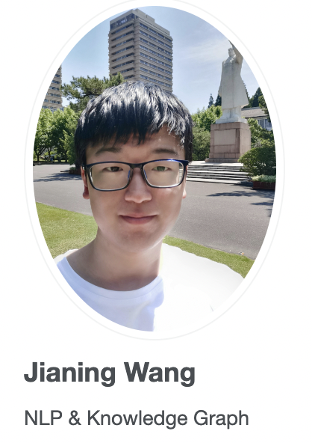

Personal Introduction
5th year PhD at ECNU, Shanghai, China
Visiting Graduate at UCSD, SD, USA
Homepage: https://wjn1996.github.io/
Email: lygwjn@gmail.com
Github: https://github.com/wjn1996
Large Language Models
Few-shot Learning
Contact Me
Notes:
I have compiled some research directions on large models for your reference.
I think there are currently some research topics in LLM. I think we will see more publications on these topics that accepted in the following conference, such as ACL, EMNLP, NIPS, and so on.

Slide 3
Main Topics of LLMs
New Topic: Graph-enhanced LLMs
Position Extensive
Hallucination of LLMs
Training Tech. for LLMs
RoPE、Transformer-XL、
ALIBI、KERPLE、XPOS
Faithfulness
Factuality
consistency
MoE、BF16、FlashAttn、DeepSpeed…
LLM as a Agent
AutoGPT、LangChain
Prompt-tuning for LLMs
Graph-enhanced
LLMs
LLMs
Alignment
Discrete template、soft prompt、peft, instruction
RLHF、DPO
Task-specific Applications
Elicit LLMs Reasoning
Multi-modal LLMs
Medical LLM, Education LLM
Search-Adv.-Rec.
In-context learning、chain-of-thought、Theory-of-mind
ViT、Diffusion
Notes:
I have compiled some research directions on large models for your reference.
I think there are currently some research topics in LLM. I think we will see more publications on these topics that accepted in the following conference, such as ACL, EMNLP, NIPS, and so on.

Slide 4
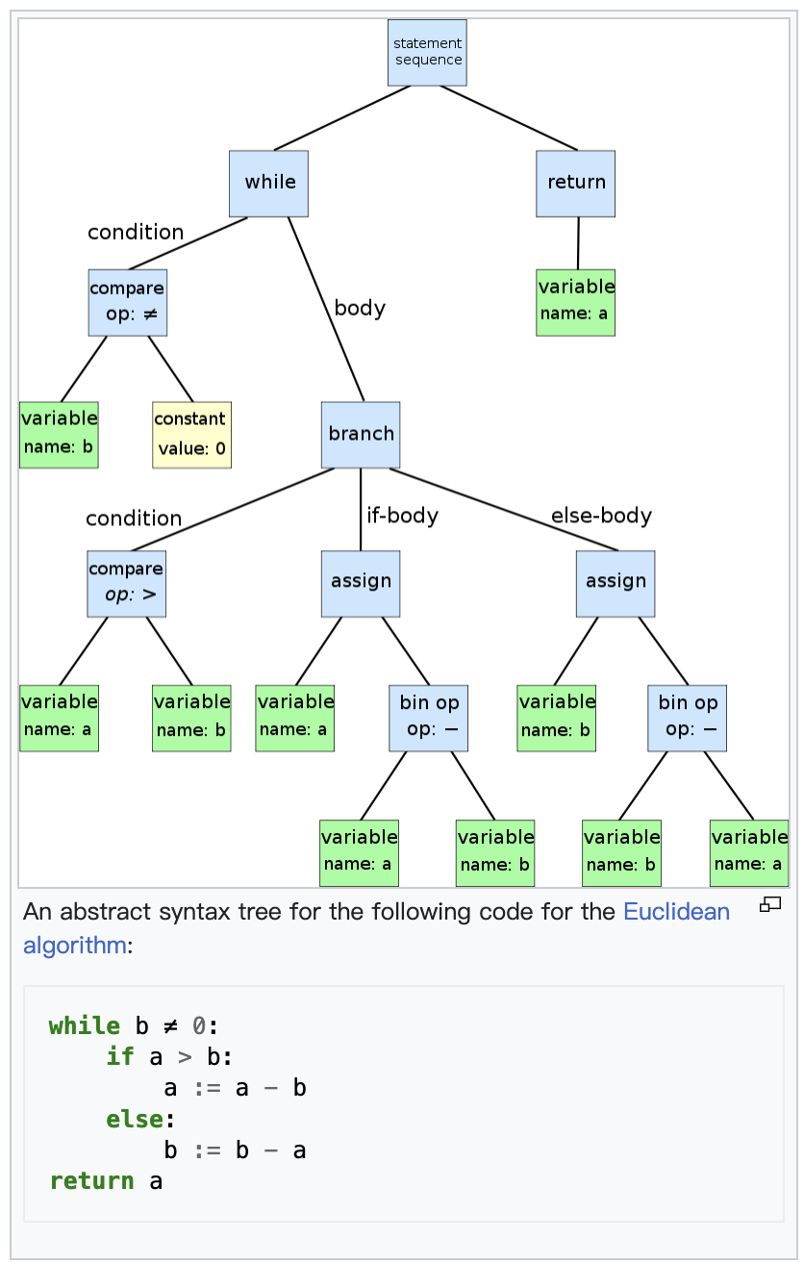
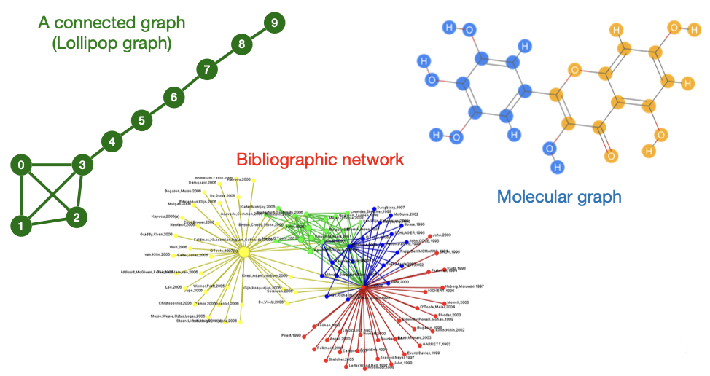
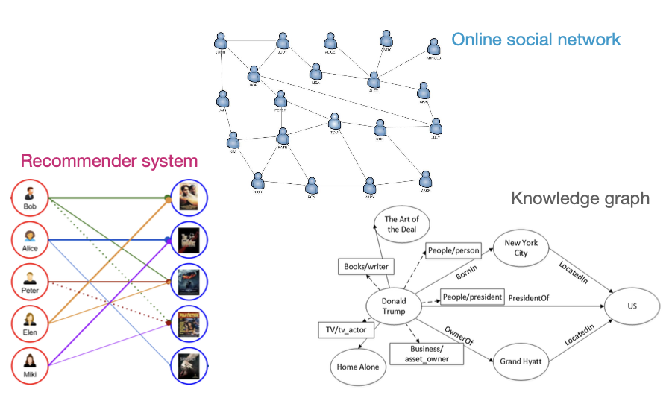
What’s Graph-enhanced LLM?
Graph Category
Graph Structure Data V.S. Textual Data
Graph Aligning to Text
🤔
Notes:
There are many graph structure data in the world, such as
mathematics graph, chemical graph, social network, citation graph, collaboration graph, knowledge graph, code AST

Slide 5
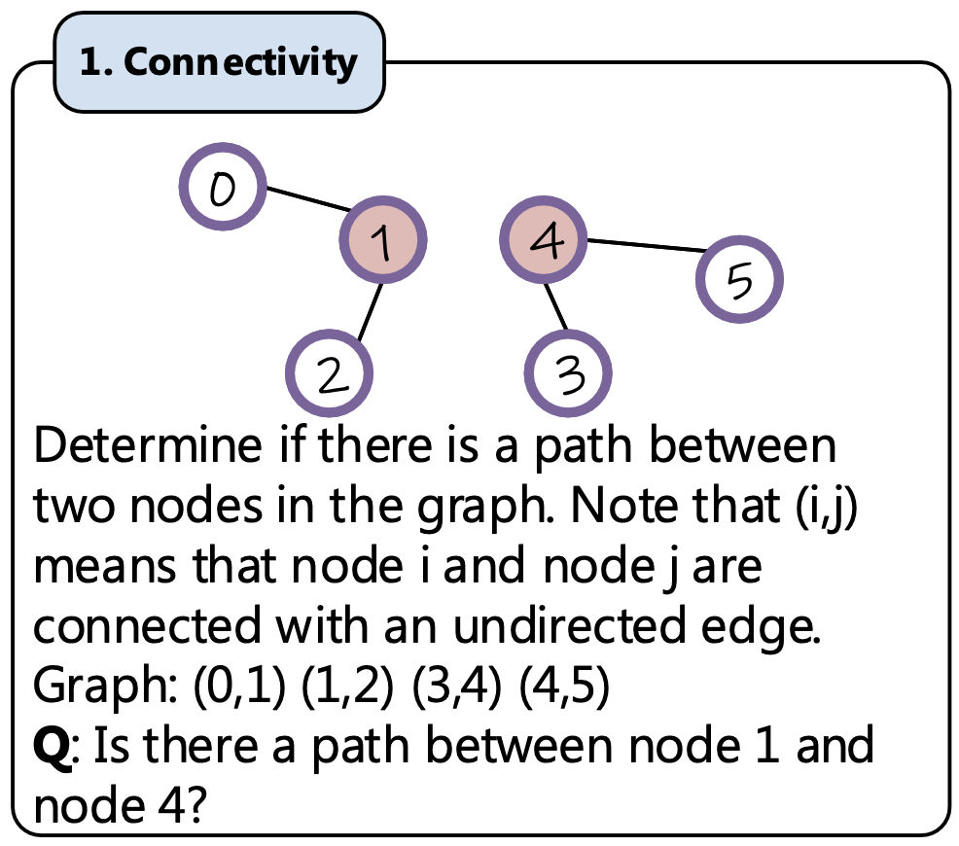
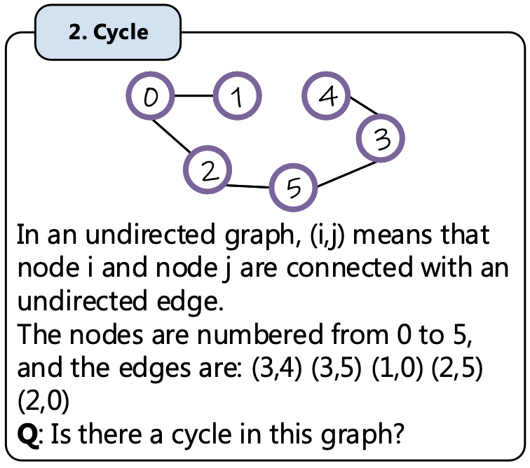
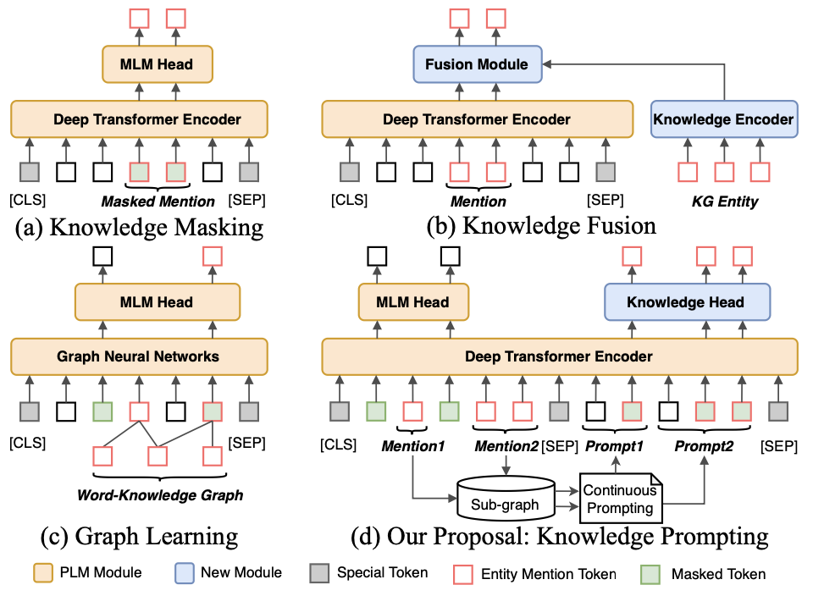
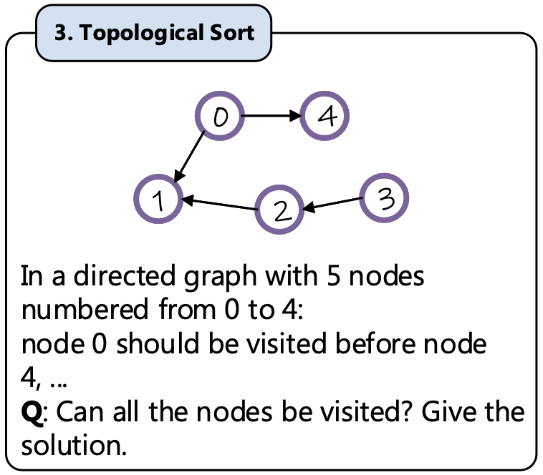
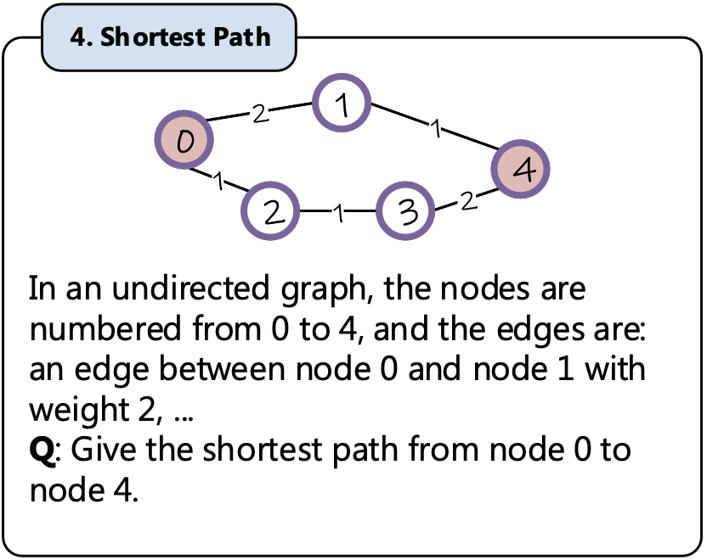
What’s Graph-enhanced LLM?
Two Corners
LLM Training on Graph
LLM Reasoning on Graph

Slide 6
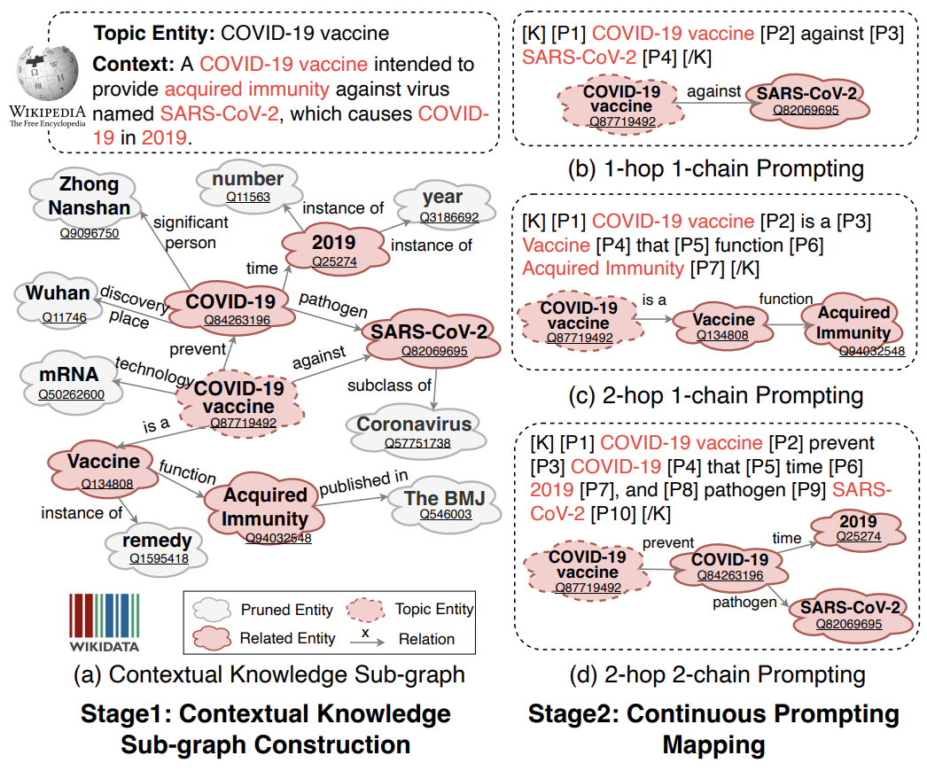
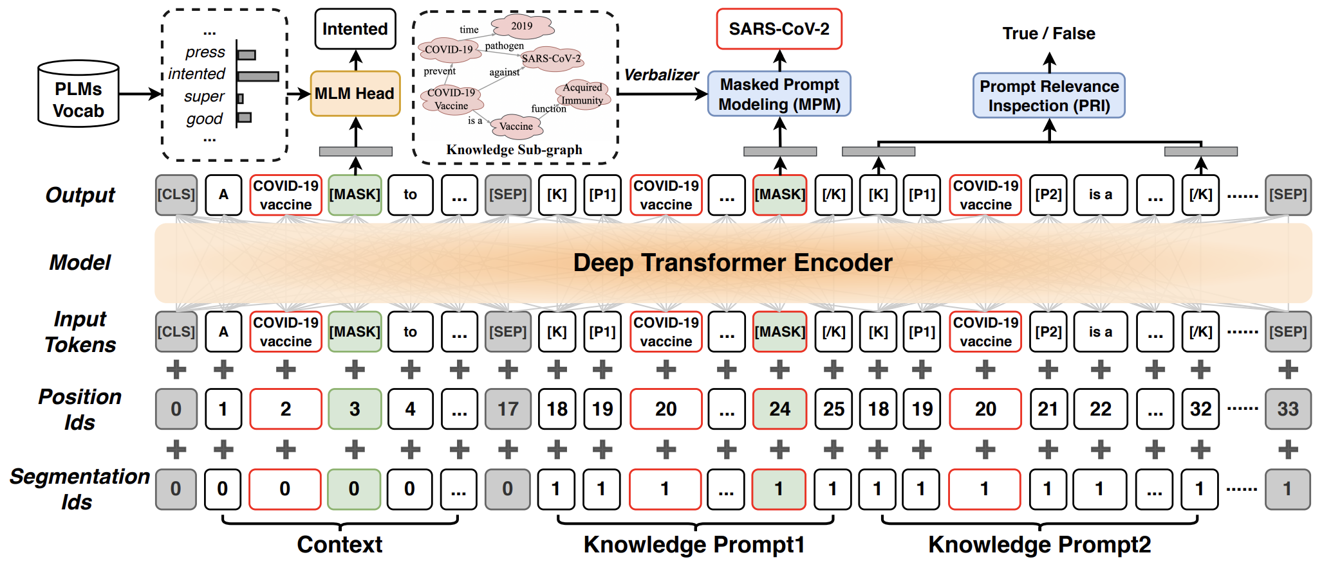

What We Have Done?
Injecting KG into LLMs
Step 1: Transform Graph to Prompt
Each multi-hop chain can be view as knowledge prompt
Step 2: Injecting Prompt into LLM
Concatenate each knowledge prompt
Jianing Wang , Wenkang Huang, Minghui Qiu, Qiuhui Shi, Hongbin Wang, Xiang Li, Ming Gao: Knowledge Prompting in Pre-trained Language Model for Natural Language Understanding. EMNLP 2022C: 3164-3177

Slide 7
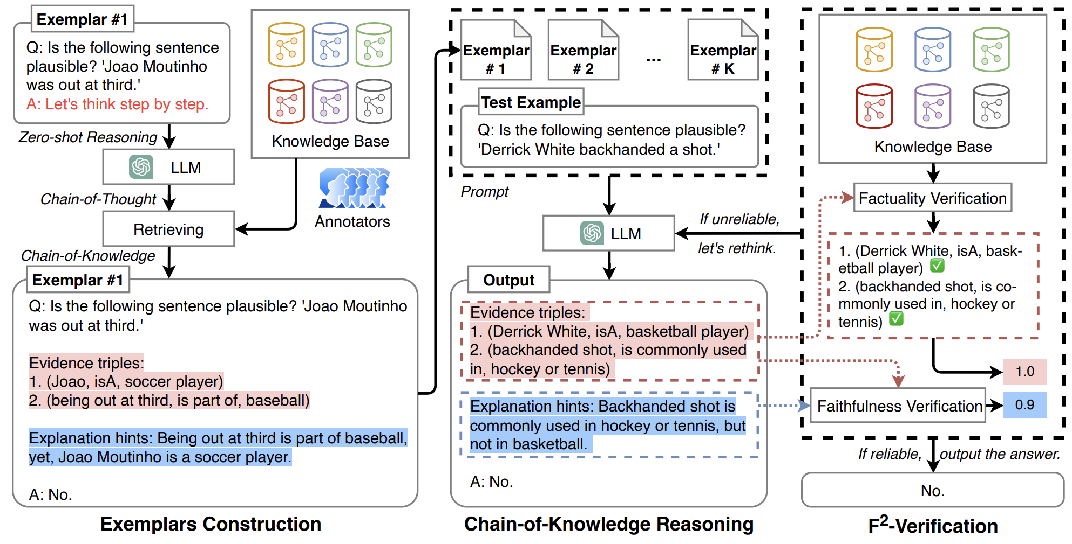
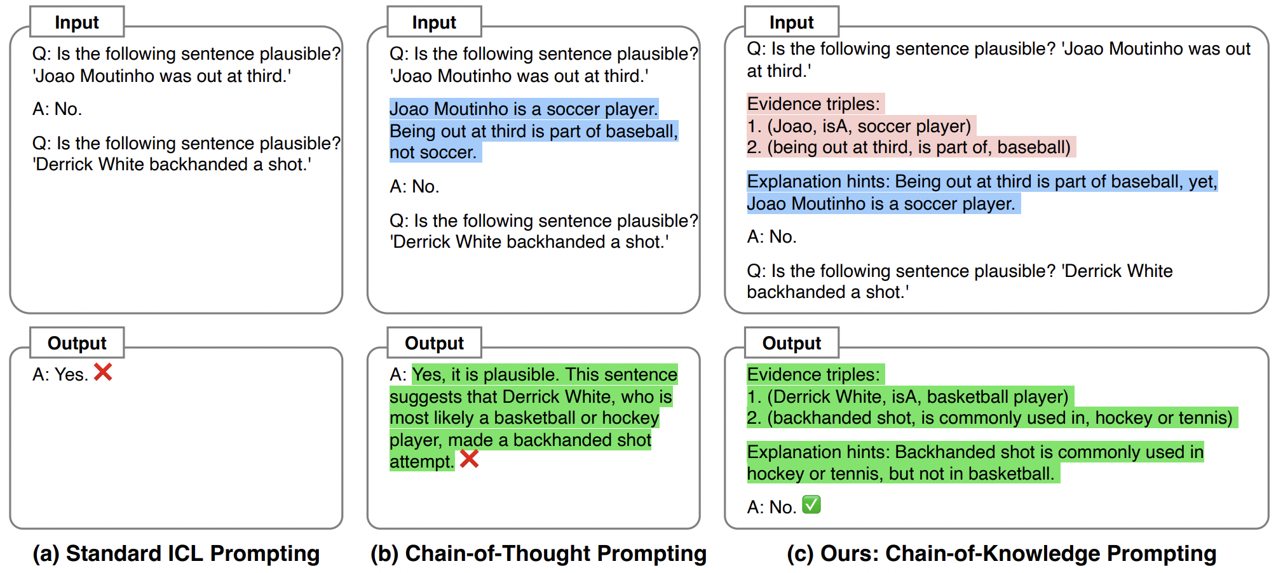
What We Have Done?
KB as a verifier for LLM
Define Chain-of-Knowledge Prompting to elicit LLMs generate explicit evidence triple.
Design Factuality & Faithfulness Verification to evaluate the hallucination by matching each generated evidence triple and explanation with KB, and let LLM rethink when generating false evidence triple.
Jianing Wang, Qiushi Sun, Nuo Chen, Xiang Li, Ming Gao: Boosting Language Models Reasoning with Chain-of-Knowledge Prompting. CoRR abs/2306.06427e (2023)

Slide 8
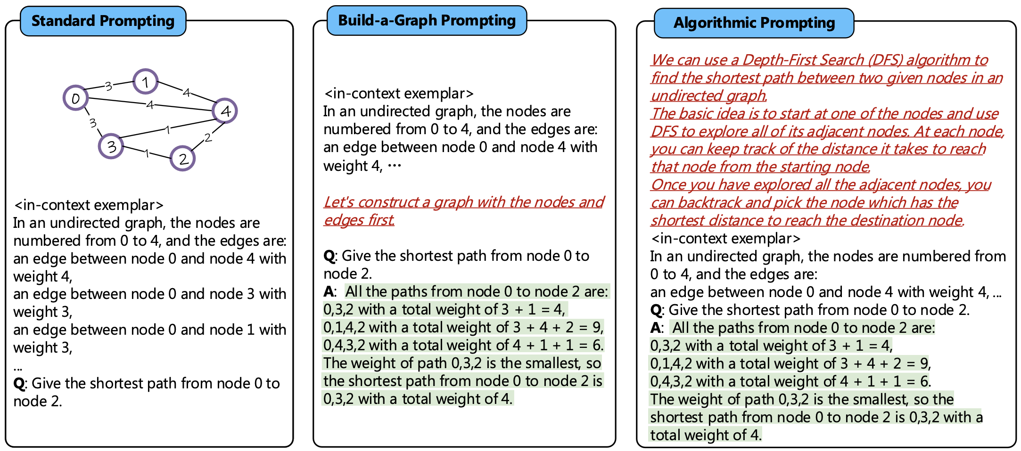
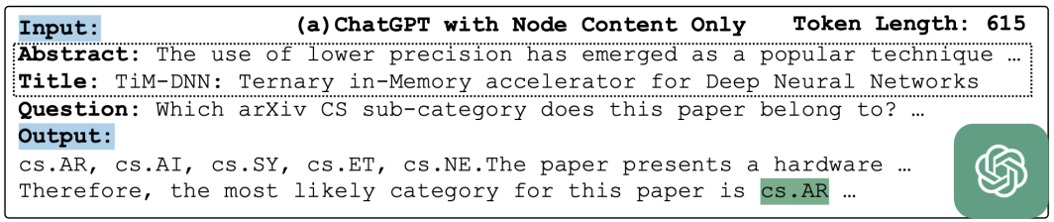
What We Will Do?
How to elicit LLMs to better understand Graph?
How to make LLMs better Graph Reasoner?
Related Works
Graph2Text: Design Instruction and Prompt format to align graph data to text.

Slide 9
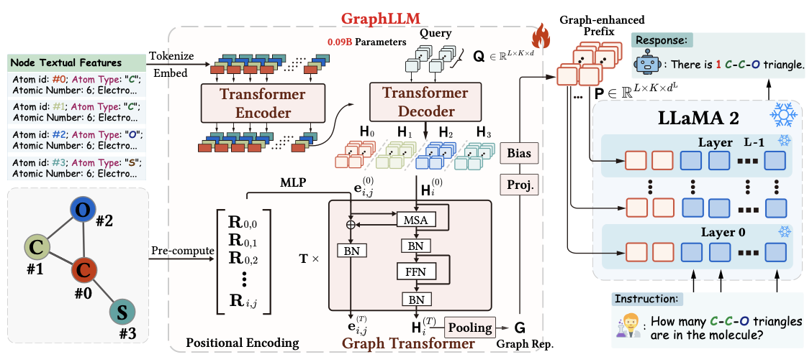
What We Will Do?
How to elicit LLMs to better understand Graph?
How to make LLMs better Graph Reasoner?
Related Works
Graph Encoder as PEFT: Design graph-based encoder (GNN, Graph Transformer, etc) to encode the graph, and inject the representations into LLMs with parameter-efficient learning.

Slide 10
What We Will Do?
How to elicit LLMs to better understand Graph?
How to make LLMs better Graph Reasoner?
On-going research w/ Junda, Yupeng.
Our Motivations
Inflexible & Inefficient: Using a graph-specific encoder to inject graphs into LLM may introduce additional complex networks, resulting in time-consuming reasoning.
Graph-based Hallucination: Previous works ignore of hallucination about Graph and Text, such as LLM misunderstand the Graph, or, the Graph contains information that conflicts with LLMs. It is necessary to reduce the inconsistency.
Our Contributions
Better Format: Design unified graph-to-text format to better elicit LLMs to understand the graph.
Adequate Instruction Task: Propose more and abundant graph-text tasks to instruct LLMs to response with the graph.
Alignment on Graph: Introduce Alignment Stage based on Graph to reduce the hallucination.
Reasoning Task: Graph structure, KBQA, RecSys, Link prediction, Node CLS, CommonsenseQA, …

Slide 11
THANK YOU FOR LISTENING
Jianing Wang（王嘉宁）
2023-11-09

